Slide 1


Data Structures
Lab # 3 Pointers

Slide 2
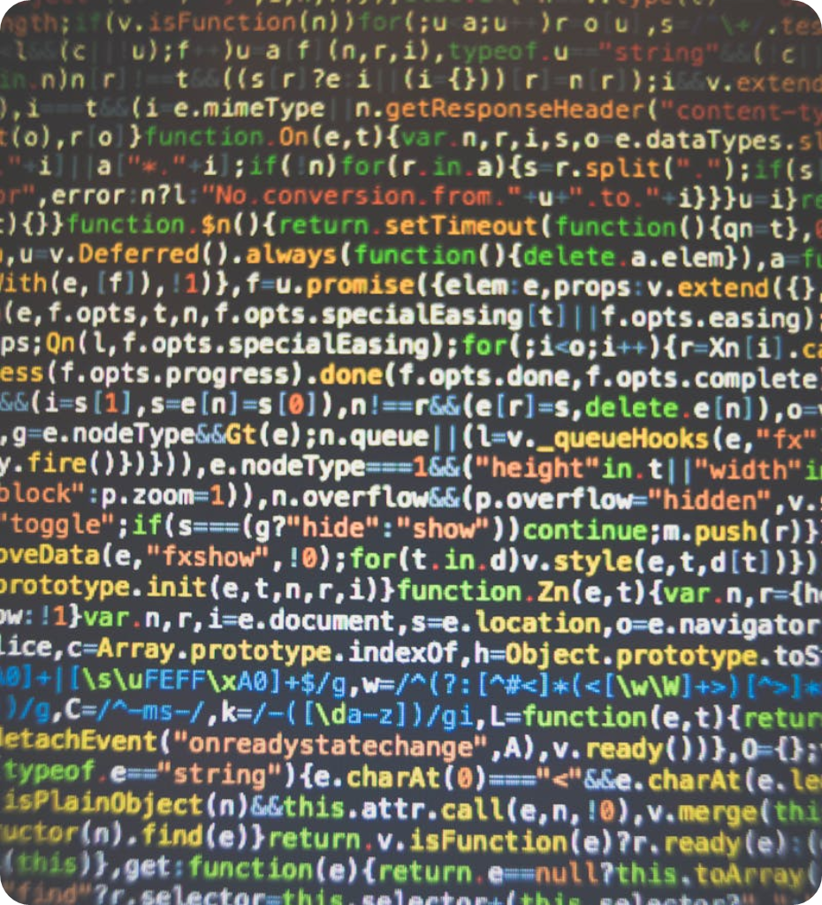
Pointers
Points to Another Type
Holds the memory address of another variable
Used for indirect access to other variable
Declared with * operator
Example: int *ptr

Slide 3
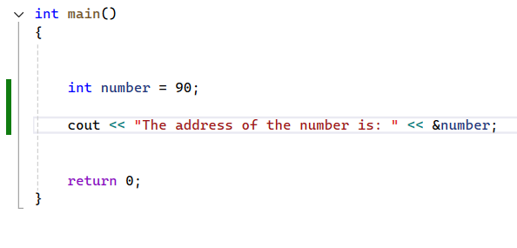
Address of Operator
& is the address of the operator
When applied to any variable, we get the address of that variable

Slide 4
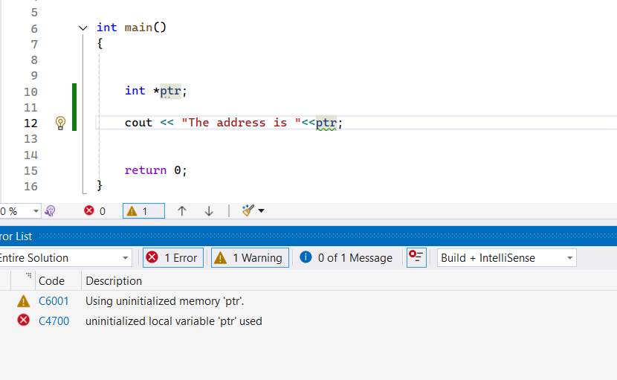
Pointer Declaration
If a pointer is declared but not initialized it contains some garbage value. However modern compilers does not compile without initialization.

Slide 5
Pointer
int *ptr= &number;
10
int number = 10;
number
&number
0000009FFFF7FCF4

Slide 6
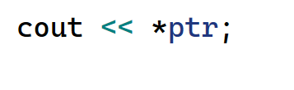
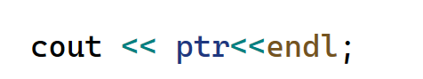
Pointer
int *ptr= &number;
10
10
number
&number
0000009FFFF7FCF4

Slide 7
Problem Statement: “Pointer Café – Coffee Billing System”
Scenario
You are working at a small café that sells 3 types of coffee: Espresso, Latte, and Cappuccino.
You need to write a C++ program that calculates the total bill, but with a twist: you must use pointers to access and modify variables.

Slide 8
Function Pointers
Holds the address of the Function
The type is same as the signature of the function (Return type & Arguments)
returnType (* PointerIdentifier) (Arguments) = &Function

Slide 9
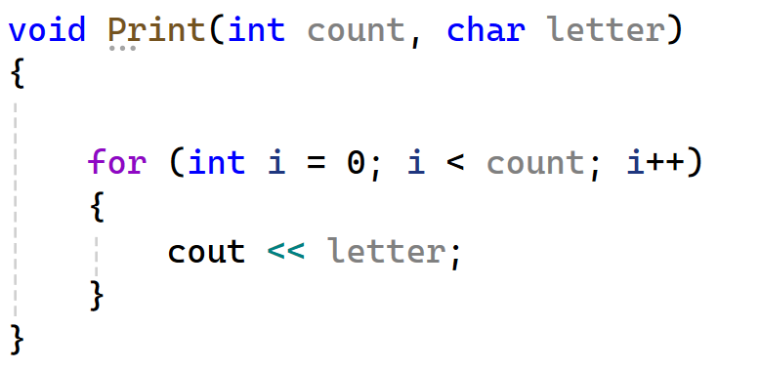
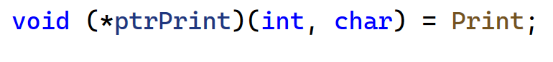
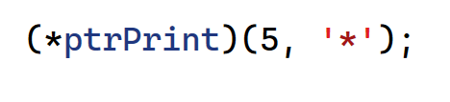
Function Pointer
Declaration: returnType (* PointerIdentifier) (Arguments) = &Function
Calling: (* PointerIdentifier) (Arguments)
Declaration of Function Pointer
Calling a Function Pointer

Slide 10
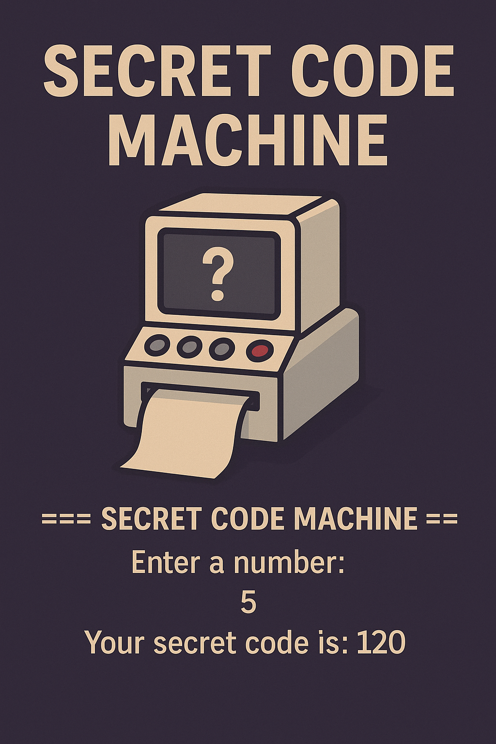
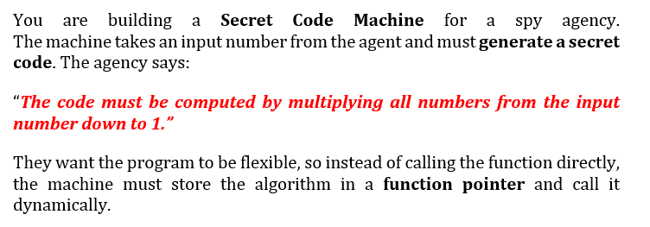

Slide 11

THANK YOU!

